Slide 2
Python for the Enterprise
Kevin Kuhls, TME EISG
DEVNET-2449

Slide 3
Agenda
Programmability
YANG
NETCONF

Slide 4
Why Network Programmability Matters
Network Expenses
Deployment Speed
Computing
Networking
100%
67%
33%
0
CAPEX
OPEX
Seconds
0
10
100
1000
Source: Forrester
Source: Open Compute Project
DEVNET-2449

Slide 5
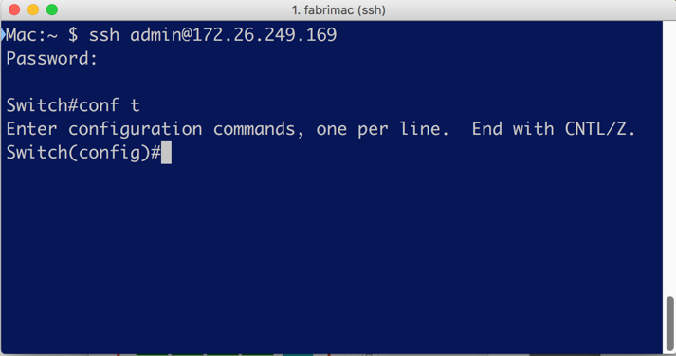

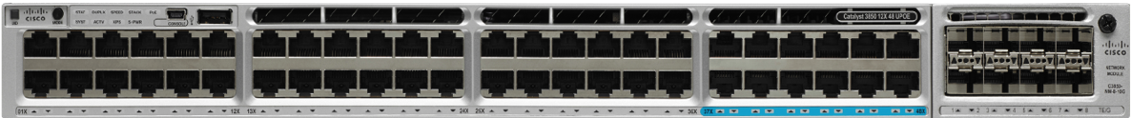
Configuration Management Today
CLI
CLI
Physical and Virtual Network Infrastructure
Notes:
CLI scripting has several limitations including lack of transaction management, no structured error management and ever changing structure and syntax of commands that makes scripts fragile and costly to maintain. These are all side-effects of the basic fact that CLIs are designed to be used by humans and not an API for programmatic access.
Human interface – created for humans and weave back to quotes, how can this be automated? Expect based, contectual scripting
Expect is not the disease it was the symptom/bandaid

Slide 6


Configuration Management Today: CLI
Human Friendly
Task Oriented
Easy To Replay
No Special Tools
Syntax format changes
No Structured output
No Error Reporting
No Transaction
management
DEVNET-2449
© 2017 Cisco and/or its affiliates. All rights reserved. Cisco Public
Notes:
Cli is great, I love it and I have established a significant relationship with CLI over the past 20 years.
However, it doesn’t fit in the machine world.
CLI scripting has several limitations including lack of transaction management, no structured error management and ever changing structure and syntax of commands that makes scripts fragile and costly to maintain. These are all side-effects of the basic fact that CLIs are designed to be used by humans and not an API for programmatic access.

Slide 7

APIs – Application Programming Interfaces
“A set of Function Calls that allow talking to a system”
Programming Building block
APIs can have various Properties
Transport (SSH, HTTP)
Encoding (XML, JSON, ProtoBuffer)
Data structure (Data Models)
Some Examples of APIs
The Twitter API
The Java API
DEVNET-2449
© 2017 Cisco and/or its affiliates. All rights reserved. Cisco Public
Notes:
So what is the answer – A programmable interface! Built with the machine in mind while not forgetting about the human.
The building blocks of the internet. API’s allow our applicatons to collaborate and become more than the sum of their parts.
Transport, encoding – we can borrow from other successful frameworks.
Models – now that is the cornerstone. We need a model to represent the network device, to describe it configuration and its state.

Slide 8
Network Programmability
Business Automation System(s)
Controller
Physical and Virtual Network Infrastructure
DEVNET-2449
Notes:
Automation System – SDN Controller, Configuration Management, Business Support (BSS) or Operations Support (OSS) System
Open Interfaces
Day 1: REST and NETCONF interfaces
Future: Python, Ruby, Object C language bindings
Standard APIs
Industry standard and Cisco standard APIs.
Industry standard APIs based upon IETF (Internet Engineering Task Force) and OpenConfig data models. OpenConfig is an informal working group of network operators sharing the goal of moving our networks toward a more dynamic, programmable infrastructure by adopting software-defined networking principles such as declarative configuration and model-driven management and operations. Initial focus is on development of vendor-neutral data models for configuration and management that will be supported natively on networking hardware and software platforms.
Cisco standard APIs are standard across two or more Cisco operating systems (IOS-XE, IOS-XR, NX-OS)

Slide 9
Network Programmability
Business Automation System(s)
Controller
Open Device Programmability
Physical and Virtual Network Infrastructure
DEVNET-2449
Notes:
Automation System – SDN Controller, Configuration Management, Business Support (BSS) or Operations Support (OSS) System
Open Interfaces
Day 1: REST and NETCONF interfaces
Future: Python, Ruby, Object C language bindings
Standard APIs
Industry standard and Cisco standard APIs.
Industry standard APIs based upon IETF (Internet Engineering Task Force) and OpenConfig data models. OpenConfig is an informal working group of network operators sharing the goal of moving our networks toward a more dynamic, programmable infrastructure by adopting software-defined networking principles such as declarative configuration and model-driven management and operations. Initial focus is on development of vendor-neutral data models for configuration and management that will be supported natively on networking hardware and software platforms.
Cisco standard APIs are standard across two or more Cisco operating systems (IOS-XE, IOS-XR, NX-OS)

Slide 10
Network Programmability
Operational
State
Configuration
Management
Traffic
Engineering
Programmatic
Interfaces
Open
Protocols
Open Device Programmability
Physical and Virtual Network Infrastructure
DEVNET-2449
Notes:
Automation System – SDN Controller, Configuration Management, Business Support (BSS) or Operations Support (OSS) System
Open Interfaces
Day 1: REST and NETCONF interfaces
Future: Python, Ruby, Object C language bindings
Standard APIs
Industry standard and Cisco standard APIs.
Industry standard APIs based upon IETF (Internet Engineering Task Force) and OpenConfig data models. OpenConfig is an informal working group of network operators sharing the goal of moving our networks toward a more dynamic, programmable infrastructure by adopting software-defined networking principles such as declarative configuration and model-driven management and operations. Initial focus is on development of vendor-neutral data models for configuration and management that will be supported natively on networking hardware and software platforms.
Cisco standard APIs are standard across two or more Cisco operating systems (IOS-XE, IOS-XR, NX-OS)

Slide 11


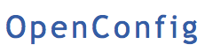

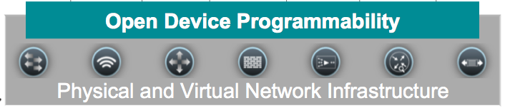
Implementation
RESTconf
NETCONF
gRPC
Other vendors
Data Model
Standard
Device Specific
Configuration
Operational
Standard
Device Specific
Device Features
Interface
BGP
QoS
ACL
…
DEVNET-2449
Notes:
Deterministic states

Slide 12

Why Data Models?
Devices are self-describing
Including definition of constraints
We can apply tool chains
New protocols and encodings
DEVNET-2449
© 2017 Cisco and/or its affiliates. All rights reserved. Cisco Public
12
Notes:
Lets start with the analogy of location services. If I want to know where I am I can look at this map. I know about where I should be based on assumptions and memory. But who looks at a map anymore? I want to use a machine. The method of figuring out where you are by examing your surroundings cant work for a machine so we created a model, grid coordinates for GPS. Now I can look at my phone and an app can represent my coordinates on a map for me to consume
Where are you, I know where I am from my head or a map, but phone can reference API and model to generate the same outcome
Location Analogy:
· CLI = Good ol Rand McNally Map
· Netconf = GPS
· RESTConf = GoogleMaps/Waze
· YANG = grid coordinates
They all focus on determining location and path, but adding programmability allows for less human error and feedback. Core “microcode” of exact location in 2-dimensional space doesn’t change, only the way to interface with that data.
Programmability extends a map to “where’s the closest gas station”, quicker/automatic course correction, traffic and construction info. Even other aps can get involved. You calendar can let you know when to leave or remind you to pick up flowers when you are close to the florist. Map will always be available to verify/reminisce, but why? We have evolved beyond that
Free Clipart Source http://www.clipartpanda.com/clipart_images/of-continents-clip-art-or-3859019

Slide 13
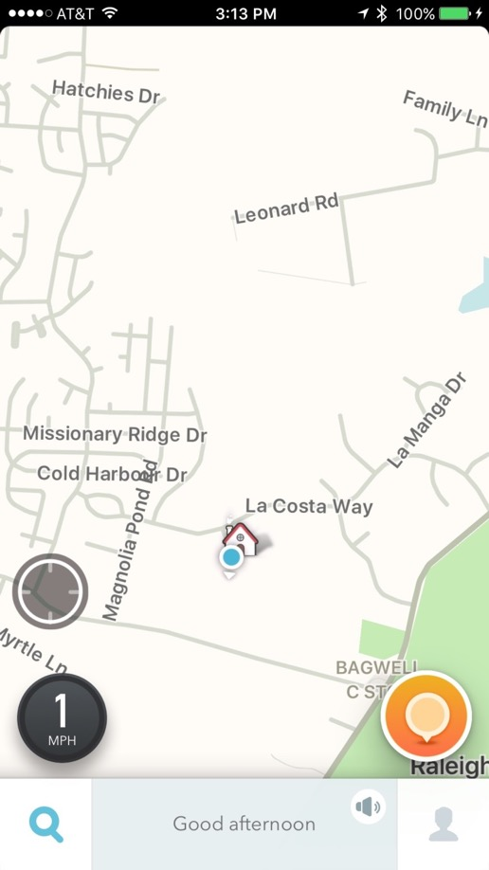
Why Data Models?
Devices are self-describing
Including definition of constraints
We can apply tool chains
New protocols and encodings
DEVNET-2449
© 2017 Cisco and/or its affiliates. All rights reserved. Cisco Public
13
Notes:
Lets start with the analogy of location services. If I want to know where I am I can look at this map. I know about where I should be based on assumptions and memory. But who looks at a map anymore? I want to use a machine. The method of figuring out where you are by examing your surroundings cant work for a machine so we created a model, grid coordinates for GPS. Now I can look at my phone and an app can represent my coordinates on a map for me to consume
Where are you, I know where I am from my head or a map, but phone can reference API and model to generate the same outcome
Location Analogy:
· CLI = Good ol Rand McNally Map
· Netconf = GPS
· RESTConf = GoogleMaps/Waze
· YANG = grid coordinates
They all focus on determining location and path, but adding programmability allows for less human error and feedback. Core “microcode” of exact location in 2-dimensional space doesn’t change, only the way to interface with that data.
Programmability extends a map to “where’s the closest gas station”, quicker/automatic course correction, traffic and construction info. Even other aps can get involved. You calendar can let you know when to leave or remind you to pick up flowers when you are close to the florist. Map will always be available to verify/reminisce, but why? We have evolved beyond that
Free Clipart Source http://www.clipartpanda.com/clipart_images/of-continents-clip-art-or-3859019

Slide 14
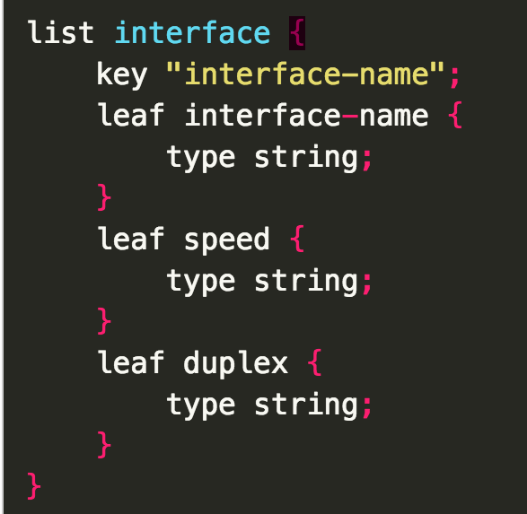
Data Models
Interface Model definition
Explicitly and precisely defines Data
Structure
Syntax
Semantics
Consistent and complete
DEVNET-2449
© 2017 Cisco and/or its affiliates. All rights reserved. Cisco Public
Notes:
Why and what – focus on the why
Now lets describe our network element in programmatic terms and data structures like lists, strings, booleans, etc and organize them in a machine freindly tree structure

Slide 15
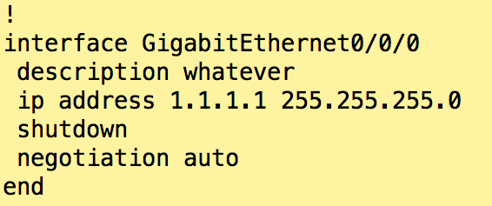
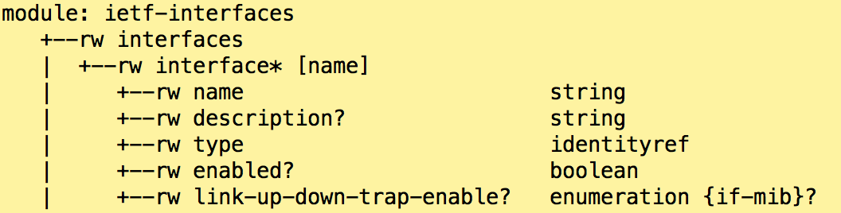
YANG Data Model Structure
Look familiar?
Description of all interfaces
Can be named, described, typed, enabled (or not), set for traps
DEVNET-2449
© 2017 Cisco and/or its affiliates. All rights reserved. Cisco Public
15
Notes:
Heirarchical structure to repesent the configurable elements
This is starting to look familiar. Its Not so scary
We can make a model for a machine to consume, but it can still look reminiscent of the cli structure we all have learned.

Slide 16
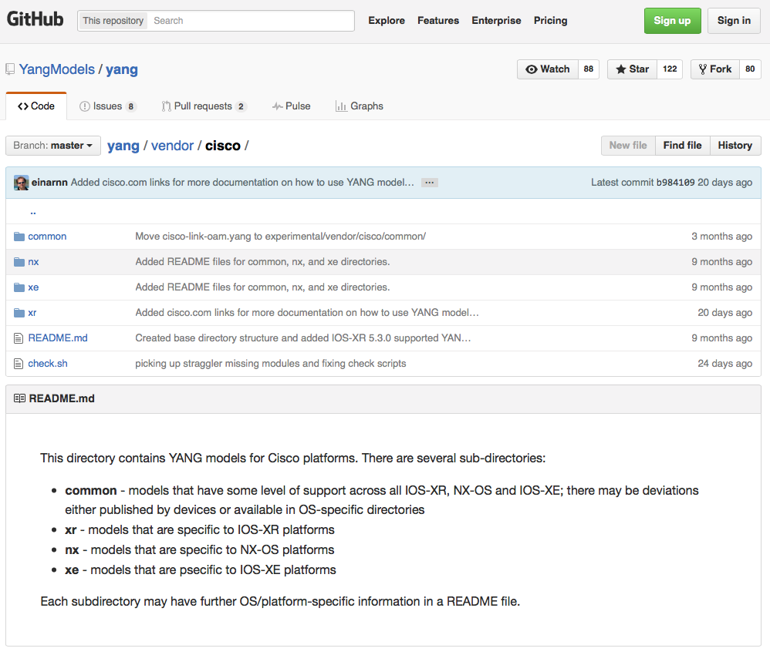
Where to get the Models?
https://github.com/YangModels/yang “YANG modules from standard organizations such as the IETF, open source such as Open Daylight or vendor specific modules”
https://github.com/CiscoDevNet/xe-netconf-yang **
During a lab, like here ☺
DEVNET-2449

Slide 17
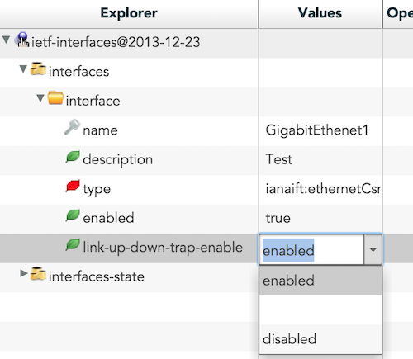
Tools to work with YANG Models
pyang ‘An extensible YANG validator and converter in python’
https://github.com/mbj4668/pyang
Via PyPi: pyang - A YANG (RFC 6020) validator and converter
Mandatory tool ☺
YANG Explorer ‘An open-source YANG Browser and RPC Builder Application’
https://github.com/CiscoDevNet/yang-explorer
Web Based GUI
More difficult to get started with
DEVNET-2449

Slide 18
NETCONF Overview
Management info
(definition)
e.g., YANG modules
Manager (client)
Management info
(instantiated/payload)
XML-encoded content
Several data stores:
Running
Startup
Candidate
Management
Services
NETCONF operations
<edit-config>, <get-config>, <get>
Agent
(server)
Remote
Operations
Netconf RPC
<rpc>, <rpc-reply>
XML content per YANG
Conceptual
Data Store
Transport
TLS, SSH
DEVNET-2449
Notes:
Netconf has the concept of datastores – running startup and candidate
Candidate is like on XR where you need to commit changes
Only running is mandatory
Not all are writeable, for example some devices force you to make changes to a non-writeable data store, copy from a writable one
Not all data stores are writable
Check the device’s capabilities
To make changes to a non-writeable data store, copy from a writable one

Slide 19
NETCONF Capabilities
How do I know what a box can support?
Many other ways too.
This is the capabilities exchange defined by the RFC
Can I download all these models to help me code?
This is great for integrating.
ssh -p 830 vagrant@172.20.20.10 -s netconf
<get-schema xmlns="urn:ietf:params:xml:ns:yang:ietf-netconf-monitoring"> </get-schema>
DEVNET-2449
© 2017 Cisco and/or its affiliates. All rights reserved. Cisco Public
19
Notes:
How can I validate it was turned on correctly? Simple ssh to it on port 830 with the netconf flag
And you will get the list of models that device can support back in the handshake
Get-schema and you get all the models come back to engage the device
the capabilities exchange here, lets you (or your piece of software) understand HOW you can manipulate the router.

Slide 20
NETCONF Operations
Main Operations | Description
<get> (close to ‘show ?’) | Retrieve running configuration and device state information
<get-config> (close to ‘show run’) | Retrieve all or part of specified configuration datastore
<edit-config> (close to ‘conf t’) | Loads all or part of a configuration to the specified configuration datastore
Other Operations | Description
<copy-config> | Replace an entire configuration datastore with another
<delete-config> | Delete a configuration datastore
<commit> | Copy candidate datastore to running datastore (ex: XR)
<lock> / <unlock> | Lock or unlock the entire configuration datastore system
<close-session> | Graceful termination of NETCONF session
<kill-session> | Forced termination of NETCONF session
DEVNET-2449
© 2017 Cisco and/or its affiliates. All rights reserved. Cisco Public
Notes:
Here are the operations you can perform via netconf, very similar to http transactions
you can filter the requests to get a subset of the data
What do you want to do if you do configuration automation
retrieve config
edit config
might want to copy from one place to another
if os supports it, have the ability to do commit (IOS XR)
being able to lock and unlock config so that others can’t make changes while you are
can also get operational state
can get some state through netconf
fairly sophisticated - not simple crud read/write
this is not a complete list
Netconf also takes into account the notion of different data stores
runnign config
startup config
ftp / from a url

Slide 21
NETCONF Stack
Message - RPC
<rpc message-id="101" xmlns="urn:ietf:params:xml:ns:netconf:base:1.0">
<get>
<filter>
<interfaces xmlns="urn:ietf:params:xml:ns:yang:ietf-interfaces">
<interface>
<name>GigabitEthernet1/0/1</name>
</interface>
</interfaces>
</filter>
</get>
</rpc>
Operation
Content
DEVNET-2449
© 2017 Cisco and/or its affiliates. All rights reserved. Cisco Public
Notes:
So lets quickly examine the structure of a Netconf call
RPC – netconf messages are remote procedure calls
Operation verb to describe message intent
Content – notice its in XML format

Slide 22

Three Things to Like about NETCONF
Capability discovery, model download
Transactions
Notifications
DEVNET-2449
© 2017 Cisco and/or its affiliates. All rights reserved. Cisco Public
22
Notes:
Easy capability discovery as part of the initial handshake with the device, you can even download the models the device supports to take a sloce look at your options
Transations – all or nothing. There is also a concept of confirmed commmit where even save a properly formatted bad config change will rollback without a confirmed commit message
Notification of success of intent

Slide 23
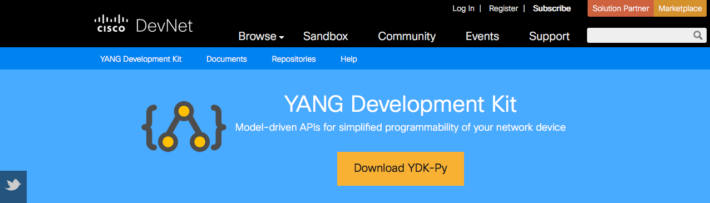


YDK – The YANG Development Kit
https://developer.cisco.com/site/ydk/
YDK turns YANG models in Python classes

Slide 24

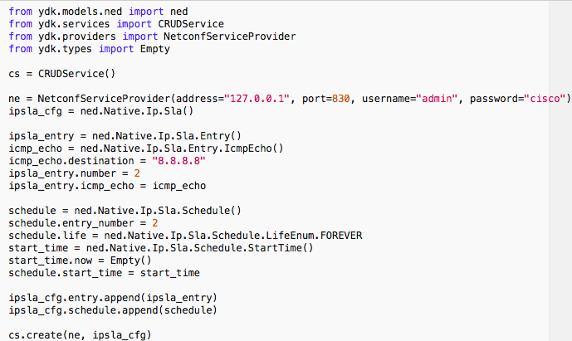
Example – Configure and Monitor IPSLA
Using YDK
All the model XML becomes Python object code
Creates the XML…
…Performs the NETCONF <edit-config>

Slide 25
DEVNET-2449

Slide 26

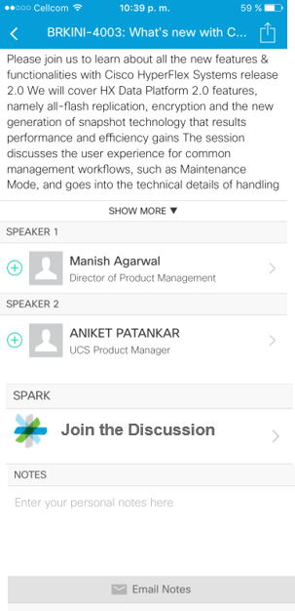

Cisco Spark Ask Questions, Get Answers, Continue the Experience
Use Cisco Spark to communicate with the Speaker and fellow participants after the session
Download the Cisco Spark app from iTunes or Google Play
Go to the Cisco Live Berlin 2017 Mobile app
Find this session
Click the Spark button under Speakers in the session description
Enter the room, room name = DEVNET-2449
Join the conversation!
The Spark Room will be open for 2 weeks after Cisco Live
DEVNET-2449

Slide 27
Continue Your Education
Demos in the Cisco campus
Walk-in Self-Paced Labs
Lunch & Learn
Meet the Engineer 1:1 meetings
Related sessions
DEVNET-2449

Slide 28














Use Cases
SDN Controller
Integration
Application
Integration
OSS / BSS
Integration
Open SDN
Controller
Custom
Application
Configuration Mgmt
Configuration Mgmt
Script Automation
Access Control
Service Provisioning
DevOps
Inventory / Topology
Fault Mgmt
DEVNET-2449
Notes:
STANDARD MODEL - Very stable and only change if standard definition changes
CISCO COMMON MODEL –
CISCO PLATFORM SPECIFIC MODEL - Model changes in conjunction with associated command changes
Operations support / business support systems

Slide 29
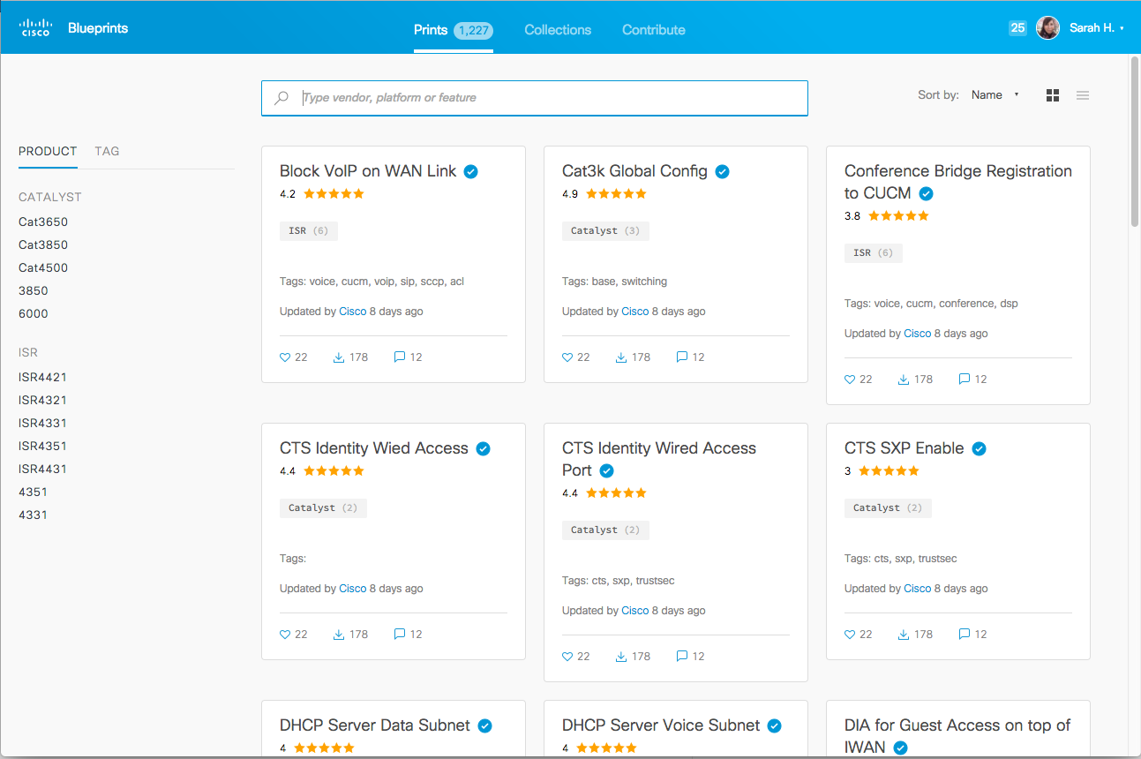
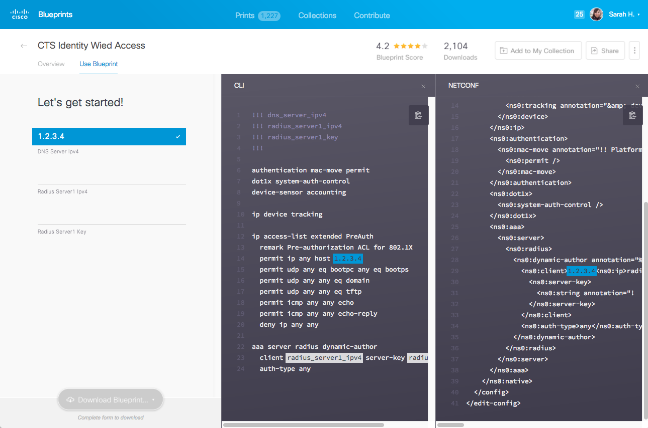
Cisco Configuration Blueprints

Slide 30
Q & A

Slide 33
Resources

Slide 34
Building the Environment
This is a rough guideline how to bring up / prepare the entire environment.
Git client
VirtualBox 5.0.28
Vagrant 1.8.7 (be aware of this issue)
cdrtools (in particular mkisofs)
a build environment (e.g. compiler, make, ...), suggest to use MacPorts or Brew if running on a Mac
Clone the iso-xrv-x64-vbox repository from GitHub
IOS XE image from Cisco.com (e.g. here, then go to IOS XE Software and download the Denali-16.3.2 .iso file in the Latest tree branch, ~350MB in size)

Slide 35
Building the Environment (cont)
Building the Vagrant Box
Go to the directory where you cloned the iso-xrv-x64-vbox repository. Start the Vagrant box image build by running the following command
iosxe_iso2vbox.py -v ~/Downloads/csr1000v-universalk9.16.03.02.iso
This will take a while. When done, you need to install the resulting box into Vagrant:
vagrant box add --name iosxe csr1000v-universalk9.16.03.02.box
(See the output at the end of the script. It has the exact location of the generated box file and also the command to add / replace the Vagrant box file).

Slide 36
Configure and Start Routers
The next steps are required to prepare configuration disks for the routers
Clone this repo from GitHub into a new directory: https://github.com/kuhlskev/devnet2449
Make sure that the Vagrant box name matches the one configured in the Vagrant file
Ensure you have the required tools installed
run make to create the ISO files with the router configurations
Bring up the routers using vagrant up (brings up both) or vagrant up rtr1 to only start rtr1

Slide 37
Resources
Interface Protocols
RESTCONF- https://tools.ietf.org/html/draft-ietf-netconf-restconf-09
NETCONF - https://tools.ietf.org/html/rfc6241
gRPC - http://www.grpc.io
Data Models
IETF - https://tools.ietf.org/html/rfc6020
ITU - https://www.itu.int/oth/T1C02000002
OpenConfig - http://www.openconfig.net/data-models
DEVNET-2449

Slide 38
Resources (cont.)
Wojciech’s CL deck ‘A Model-driven Approach to Software Defined Networks with Yang, NETCONF/RESTCONF’, BRKSDN-1903 https://www.ciscolive.com/online/connect/sessionDetail.ww?SESSION_ID=84149&tclass=popup
YANG Explorer (open source) https://github.com/CiscoDevNet/yang-explorer
SDN Tutorials: What is RESTCONF? http://sdntutorials.com/what-is-restconf/
Postman and self-signed Certs http://blog.getpostman.com/2014/01/28/using-self-signed-certificates-with-postman/
DEVNET-2449

Slide 39
Resources (cont.)
YANG Module Repository (IETF, Open, Vendors) https://github.com/YangModels/yang
Pyang tool https://github.com/mbj4668/pyang
IOS XR Site https://xrdocs.github.io/
DEVNET-2449

Slide 40
More Tools and Tips
Format JSON using a Pipe
python .\test.py | python -m json.tool
ngrok, localtunnel.me 'tunnel local ports to public URLs and inspect traffic'
Use 'jq' to process JSON in scripts
https://stedolan.github.io/jq/download/
DEVNET-2449

Slide 41
YANG

Slide 42

NETCONF Datastores – Target of Operations
“A Datastore holds a copy of the configuration data that is required to get a device from its initial default state into a desired operational state”
Running
running-config
Start-up
startup-config
Candidate
work place for creating and manipulating configuration data
Running is the only mandatory Datastore
DEVNET-2449
© 2017 Cisco and/or its affiliates. All rights reserved. Cisco Public
Notes:
Netconf has the concept of datastores – running startup and candidate
Candidate is like on XR where you need to commit changes
Not all are writeable, for example some devices force you to make changes to a non-writeable data store, copy from a writable one
Not all data stores are writable
Check the device’s capabilities
To make changes to a non-writeable data store, copy from a writable one

Slide 43
NETCONF, RESTCONF, I2RS, ODL & NSO
Mgmt info
(definition)
YANG modules
Mgmt info
(encoding)
XML-encoded content
JSON
gRPC?
JAVA DTO
various
Mgmt
Services
NETCONF operations
RESTCONF
I2RS
ODL
NSO
Remote
Operations
XML RPC
HTTP
Transport
TLS,
SSH
TCP
DEVNET-2449

Slide 44
Display a YANG Module
$ pyang -f tree <yang-file>
(restconf)$ pyang -f tree -p yang/standard/ietf/RFC yang/standard/ietf/RFC/ietf-interfaces.yang
module: ietf-interfaces
+--rw interfaces
| +--rw interface* [name]
| +--rw name string
| +--rw description? string
| +--rw type identityref
| +--rw enabled? boolean
| +--rw link-up-down-trap-enable? enumeration {if-mib}?
+--ro interfaces-state
+--ro interface* [name]
+--ro name string
+--ro type identityref
+--ro admin-status enumeration {if-mib}?
+--ro oper-status enumeration
[…]
DEVNET-2449

Slide 45
NETCONF

Slide 46
NETCONF – The Basics
NETCONF – NETwork CONFiguration Protocol
Network management protocol – defines management operations
First version in 2006, RFC 4741
Latest RFC is RFC 6241 (2011)
Does not define content in management operations (Leaves that to YANG)
DEVNET-2449

Slide 47


Why NETCONF – Informational RFC 3535
Abstract
This document provides an overview of a workshop held by the Internet Architecture Board (IAB) on Network Management. The workshop was hosted by CNRI in Reston, VA, USA from June 4 thru June 6, 2002. The goal of the workshop was to continue the important dialog started between network operators and protocol developers, and to guide the IETFs focus on future work regarding network management.
SNMP had failed
For configuration, that is!
Extensive use in fault handling and monitoring!
CLI scripting
“Market share” 70%+
configuration
DEVNET-2449

Slide 48

Implications of RFC3535 – Legacy Situation
OSS
NMS
EMS
NETCONF
Manager
Cost and complexity
No well-defined protocols and data-models
Lack of atomicity
Ordering problem
DEVNET-2449

Slide 49
Implications of RFC3535, with transactions
OSS
NMS
EMS
NETCONF
Manager
Reduced
Cost and complexity
Cost/
Value
Transactions
Models
Standardized Protocols
DEVNET-2449

Slide 50
NETCONF Overview
Management info
(definition)
e.g., YANG modules
Manager (client)
Management info
(instantiated/payload)
XML-encoded content
Several data stores:
Running
Startup
Candidate
Management
Services
NETCONF operations
<edit-config>, <get-config>, <get>
Agent
(server)
Remote
Operations
Netconf RPC
<rpc>, <rpc-reply>
XML content per YANG
Conceptual
Data Store
Transport
TLS, SSH
DEVNET-2449

Slide 51
NETCONF Sessions
NETCONF is connection-oriented
SSH, TLS as underlying transport
NETCONF client (“manager”) establishes session with server (“agent”)
Session establishment: <hello> exchange
Announce capabilities, modules, features
Session termination
<close-session>, <kill-session>
DEVNET-2449

Slide 52
NETCONF Operations
<edit-config>
target: which data store
config: the configuration to be applied
Operations:
Merge (default)
Replace
Create (error in case of already existing subtree)
Delete
Remove
Additional options (not always supported, negotiated up-front):
test-option (validate before applying)
error-option (stop[default]/ continue/ rollback on error)
<copy-config>
copy from a source to a target; target is overwritten or created
<delete-config>
cannot have <running> as target
<get-schema>
Retrieve a YANG schema
DEVNET-2449

Slide 53
NETCONF Operations (contd.)
<lock>, <unlock>
data stores only available as target as a whole, cannot just lock subtree Partial locks supported in an extension
locks apply beyond scope of NETCONF itself – cannot change contents of a data store through other management interfaces either
<get-config>
source: which data store
filter: which portions / subtree (e.g. specified using xpath)
Containment nodes
Selection nodes, list element instances, pruning of siblings
Attribute match expressions
<get>
Like <get-config>, but can include operational data
DEVNET-2449

Slide 54
<get-config>
<rpc message-id="101" xmlns="urn:ietf:params:xml:ns:netconf:base:1.0">
<get-config>
<source>
<running/>
</source>
<filter>
<interfaces xmlns="urn:ietf:params:xml:ns:yang:ietf-interfaces">
<interface>
<name>GigabitEthernet0</name>
</interface>
</interfaces>
</filter>
</get-config>
</rpc>
TECCRS-2700
© 2017 Cisco and/or its affiliates. All rights reserved. Cisco Public
54
DEVNET-2449
Notes:
Here is a specific get-config message to the box – you can see we are asking for running-config and filtering on an interface gig 0

Slide 55
<get-config> Response
<rpc-reply message-id="urn:uuid:bdb1189e-4480-11e6-8507-fa163e2846a4" xmlns="urn:ietf:params:xml:ns:netconf:base:1.0" xmlns:nc="urn:ietf:params:xml:ns:netconf:base:1.0">
<data>
<interfaces xmlns="urn:ietf:params:xml:ns:yang:ietf-interfaces">
<interface>
<name>GigabitEthernet0</name>
<type xmlns:ianaift="urn:ietf:params:xml:ns:yang:iana-if-type">ianaift:ethernetCsmacd</type>
<enabled>true</enabled>
<ipv4 xmlns="urn:ietf:params:xml:ns:yang:ietf-ip">
<address>
<ip>172.26.170.253</ip>
<netmask>255.255.254.0</netmask>
</address>
</ipv4>
<ipv6 xmlns="urn:ietf:params:xml:ns:yang:ietf-ip"/>
</interface>
</interfaces>
</data>
</rpc-reply>
DEVNET-2449
© 2017 Cisco and/or its affiliates. All rights reserved. Cisco Public
55
Notes:
And here is the response as received, but take a close look, do you know the cli counterpart?...
Show run int
Also notice the payload between this slide and the next edit-config?

Slide 56
<edit-config>
<rpc message-id="101" xmlns="urn:ietf:params:xml:ns:netconf:base:1.0">
<edit-config>
<target>
<running/>
</target>
<config>
<interfaces xmlns="urn:ietf:params:xml:ns:yang:ietf-interfaces">
<interface>
<name>GigabitEthernet0/0/0</name>
<ipv4 xmlns="urn:ietf:params:xml:ns:yang:ietf-ip">
<address>
<ip>1.1.1.1</ip>
<netmask>255.255.255.255</netmask>
</address>
</ipv4>
</interface>
</interfaces>
</config>
</edit-config>
</rpc>
TECCRS-2700
© 2017 Cisco and/or its affiliates. All rights reserved. Cisco Public
56
DEVNET-2449
Notes:
Your get-config is the framework to edit your config
Easy SW interface

Slide 57
<edit-config> Response
<rpc-reply message-id="urn:uuid:d5fa0c22-4484-11e6-9132-fa163e2846a4" xmlns="urn:ietf:params:xml:ns:netconf:base:1.0" xmlns:nc="urn:ietf:params:xml:ns:netconf:base:1.0">
<ok/>
</rpc-reply>
DEVNET-2449
© 2017 Cisco and/or its affiliates. All rights reserved. Cisco Public
57
Notes:
There is no grey area on whether the command was received

Slide 58
<edit-config> Rollback
<rpc message-id="101" xmlns="urn:ietf:params:xml:ns:netconf:base:1.0">
<edit-config>
<target>
<running/>
</target>
<config>
<interfaces xmlns="urn:ietf:params:xml:ns:yang:ietf-interfaces">
<interface>
<name>GigabitEthernet0/0/0</name>
<description>DID-ROLLBACK-WORK</description>
<ipv4 xmlns="urn:ietf:params:xml:ns:yang:ietf-ip">
<address>
<ip>blah</ip>
<netmask>255.255.255.255</netmask>
</address>
</ipv4>
</interface>
</interfaces>
</config>
</edit-config>
</rpc>
DEVNET-2449
© 2017 Cisco and/or its affiliates. All rights reserved. Cisco Public
58
Notes:
Bad data in edit rolls back the whole transaction
Notice the description was changed as well, however the transations are all or none. In this case no changes in the transaction will apply
How would a Cli any error in the middle of the script react? Not good, gives unknown outcome

Slide 59
<edit-config> Rollback Response
<error-info xmlns="urn:ietf:params:xml:ns:netconf:base:1.0" xmlns:nc="urn:ietf:params:xml:ns:netconf:base:1.0">
<bad-element>ip</bad-element>
</error-info>
DEVNET-2449
© 2017 Cisco and/or its affiliates. All rights reserved. Cisco Public
59
Notes:
And here is the response of our failed edit
the entire transaction is nullified.

